Slide 1
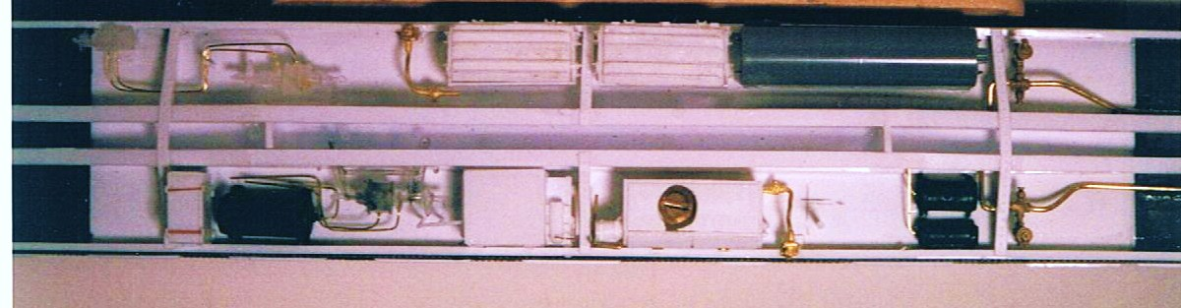
The Floor
New floor and details added
UC Brake Set
Battery boxes
S/E Valve box (2)
Battery charging receptacles (2)
APWS water tank
Vapor traps (2)
Cut away the flat side channel & replace with true 3D channel: (Evergreen .100”)
Cut out the original floor from nearly bolster to bolster & replace with a new floor.
New floor made from Evergreen sheet flush with the bottom of the old floor depth.
Cut and fit the replacement floor with great care!
New Center sill channel made from Evergreen 5/16” channel remove wedges
from the ends of the web to get the tapered look, but don’t cut away the flanges.

Slide 2
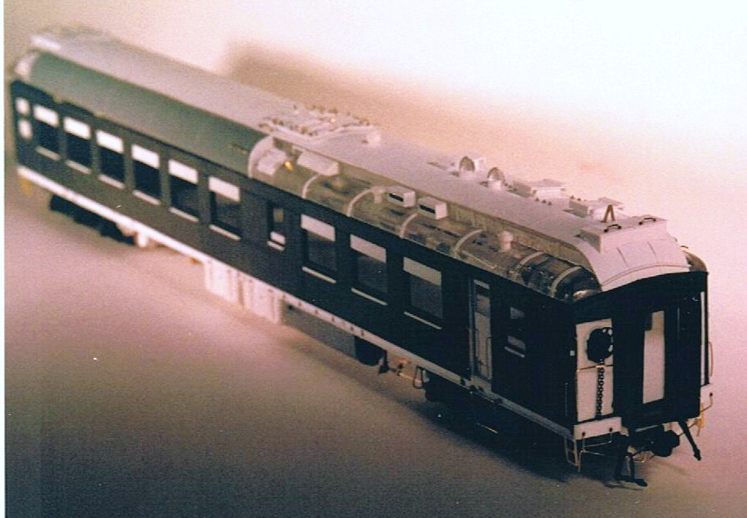
Diner details Aisle side, kitchen end
SE A/C hatches (2)
Round hooded & wind vanned Kitchen vents (2)
Square Kitchen vents (2)
Ice hatch
Gutters, scale 1” x 2” strip
preformed & glued on edge
Diaphragm
Window sills
Kitchen door
Marker light brackets
Enlarged End Sills
Stirrup steps
Body mounted KD’s
Grab irons
Cut levers
Air, steam & signal lines

Slide 3
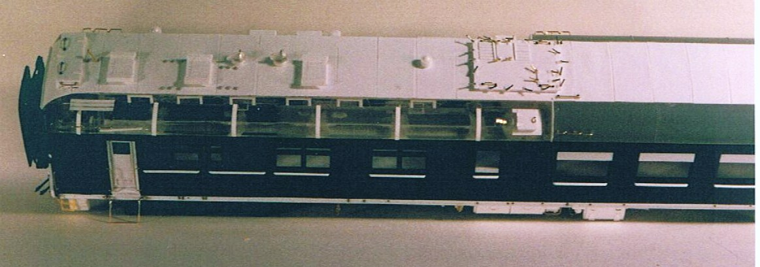
Flat Kit Side Scrabble
The diner. Build & detail the roof kitchen end, kitchen side.
The roof is a model within a model, especially so for diners with A/C.
“Ice hatch” 0.020” sides , 0.010” lid, 0.005” hinge leaf & 0.010 rod hinge , brass wire handle,
Service platform: Shim brass support legs, 2” x 3” strip for decking
Box vent: 0.010” base flange, 0.030” body, angle & sheet top
‘Mushroom” vent 1/16”rod + tube
A/C ducts: NERS parts
Gutters, scale 1” x 2” strip
preformed & glued on edge
Grab irons
(various locations)
Vent frames (6)
Lid stop brace: brass shim
Pantry area ice hatch: 0.010” base flange , 0.030” body, 0.010” lid, 0.005” hinge leaf & 0.010 rod hinge , brass wire handle,
“wind vane” vent: 1/8” tube, formed aluminum cap, 0.010” vane
Roof rivet strips 0.005”

Slide 4
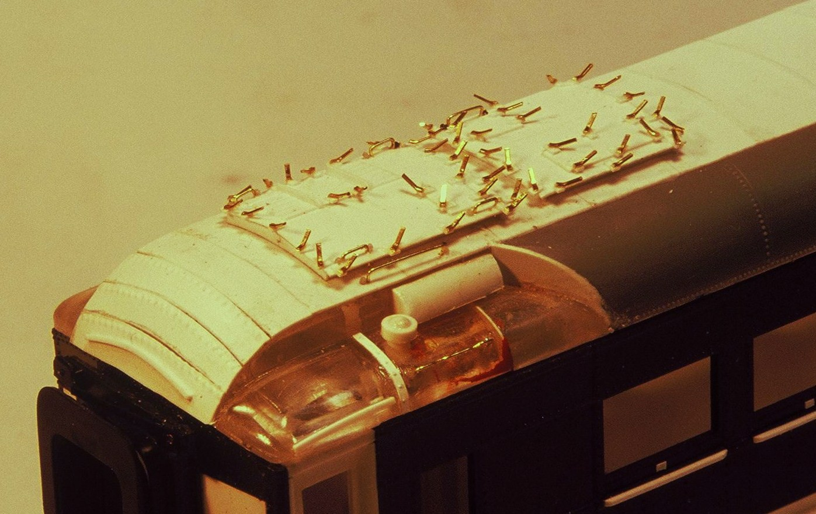
Roof Top S/E A/C hatch detailing
The café lounge shown, same components on the diner, but split locations
Roof vent , round tube trimmed & capped
Hatch cover hold down dogs: 0.010” X 0.015” flat brass bar
Hatch cover: 0.010” sheet, creased & bent for “peak”, W/ rivet detail
Hatch base: 0.030” sheet, creased & bent for “peak”
‘Mushroom” vent 1/16”I.D. rod + tube
Long grab iron with ladder notches
(various locations)
Gutters, scale 1” x 2” strip
preformed & glued on edge

Slide 5
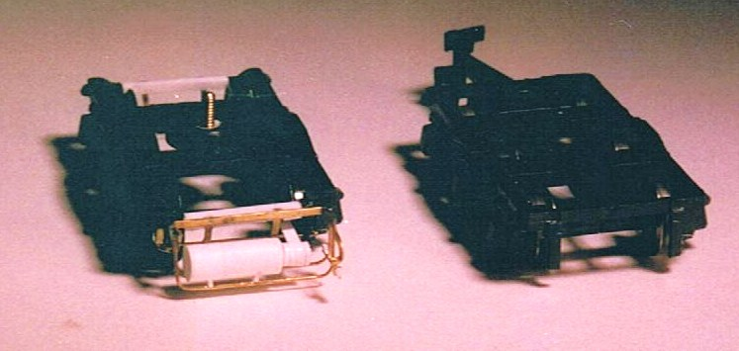
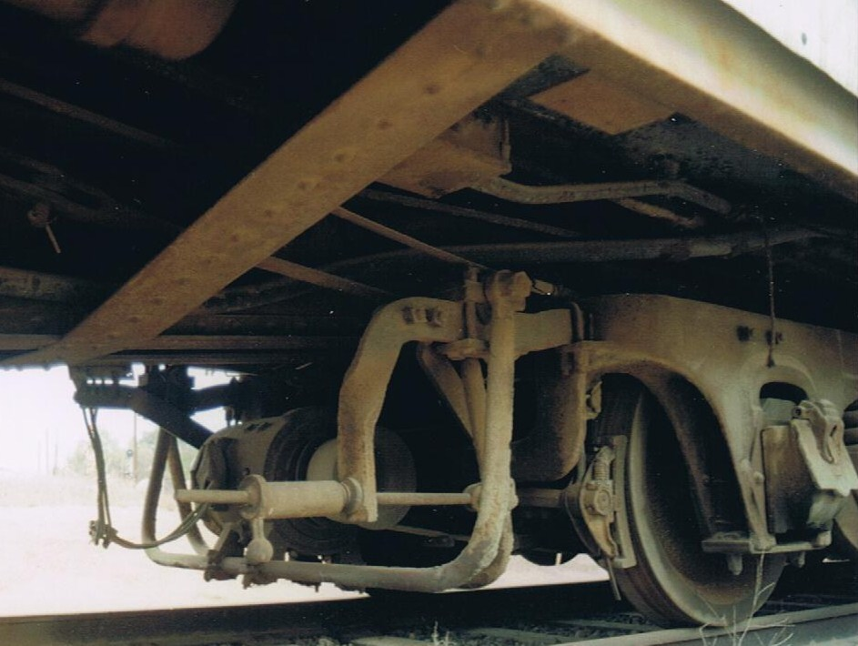
Truck Modifications
Belt tensioner
Pulley
Belt
Generator support bar (truck mounted part)
Generator
Moveable support bars

